Slide 1

DEPARTMENT OF INFORMATION TECHNOLOGY
Internet of Things
1 – Fundamentals of Internet of Things
1

Slide 2
Topic
Introduction and Characteristics of IoT
2

Slide 3
What is IoT?
“Internet of Things (IoT) is an ecosystem of connected physical objects (things) that are accessible through the internet”.
Other stmts…
“Internet of Things (IoT) comprises things that have unique identities and are connected to the Internet.

Slide 4
What is IoT? (‘thing’…cont…)
The ‘thing’ in IoT could be a person with a heart monitor or an automobile with built-in-sensors, i.e. objects that have been assigned an IP address and have the ability to collect and transfer data over a network without manual assistance or intervention.

Slide 5
Is this an IoT?
Computers Connected with Network…!...
4G enabled mobile phones?

Slide 6
Is this an IoT?
Computers Connected with Network…!...
4G enabled mobile phones?
….these things also have unique identities and are also connected with Internet….

Slide 7
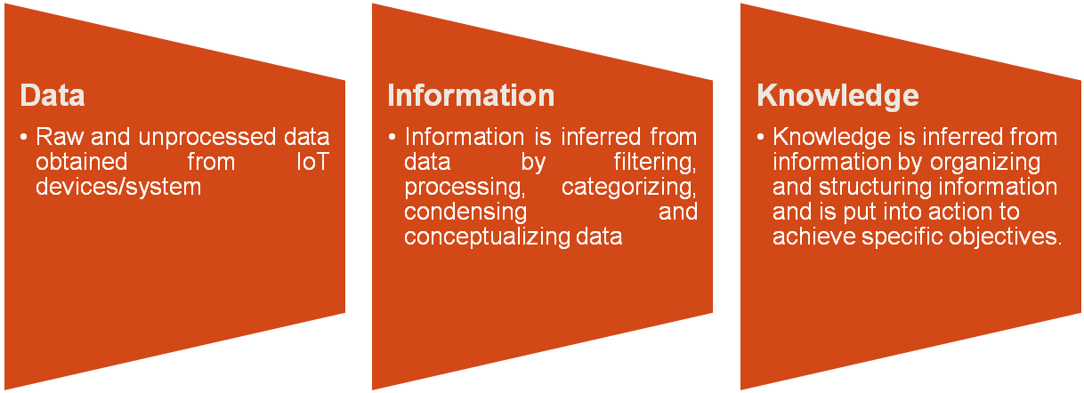
Actual Focus,,,
The scope of IoT is not limited to just connecting things (devices, appliances, machines) to the Internet.
IoT allows these things to communicate and exchange data (control & information passing for useful knowledge)..

Slide 8
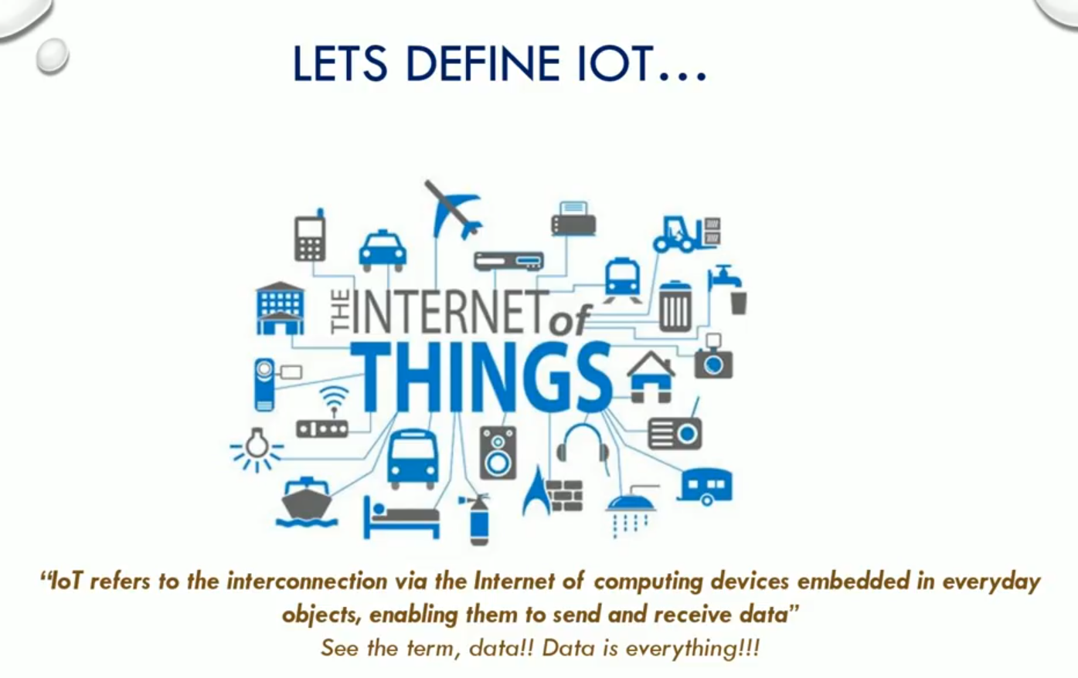

Slide 9
What is IoT? (cont…)
The embedded technology in the objects helps them to interact with internal states or the external environment, which in turn affects the decisions taken.

Slide 10
IoT (vs) Embedded System

Slide 11
IoT vs Embedded system
Embedded systems is a subset of IoT.
IoT: "A network of Internet connected objects (things) able to collect and exchange data.“
Two main parts; Internet being the backbone of connectivity, and Things meaning objects / devices .

Slide 12
IoT vs Embedded system
ie., things are nothing but your embedded system devices that sense and collect data and send it to the internet.
IoT = ET + NT + IT
Where,
Embedded Technology (ET),
Network Technology (NT)
Information Technology (IT)..

Slide 13
Practical example
"Smart air conditioning unit“ in your home that is connected to the internet.
This is a "thing" connected to the internet
Now, imagine it's a hot summer day and you have left for home from your work. You would like your home to be cool enough by the time you enter it. So, When you leave from your office, you can remotely switch ON the air conditioning unit of your home using your mobile app. Technically, with internet, you can control your AC system from any part of the world as long as both the AC and your mobile are connected using the "Internet".

Slide 14
Practical example (Further)
your mobile will command your home A/C that you are leaving the office (it can detect your GPS co-ordinates and decide your are on the move) and depending on the temperature, the A/C will be switched ON by your mobile itself, and the mobile will simply notify you that the A/C is ON.

Slide 15
Example 🡪 ET+NT+IT
your Smart A/C will have an embedded system that collects temperature data from a sensor and send it to the cloud (internet) using a wifi module. This is your Embedded system.
The Wifi network and Cloud constitute your Network Technology.
Your mobile will have an APP running in it that will receive the data. Depending on the received data, the app (in turn the mobile) will switch ON the A/C depending on your GPS co-ordinated. The mobile app infrastructure is a simple Information Technology.

Slide 16
Applications of IoT

Slide 17
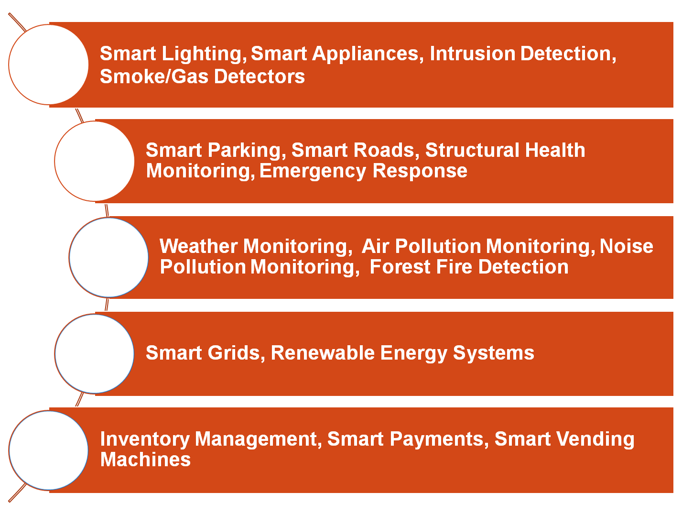
Home
Cities
Environment
Energy
Retail

Slide 18
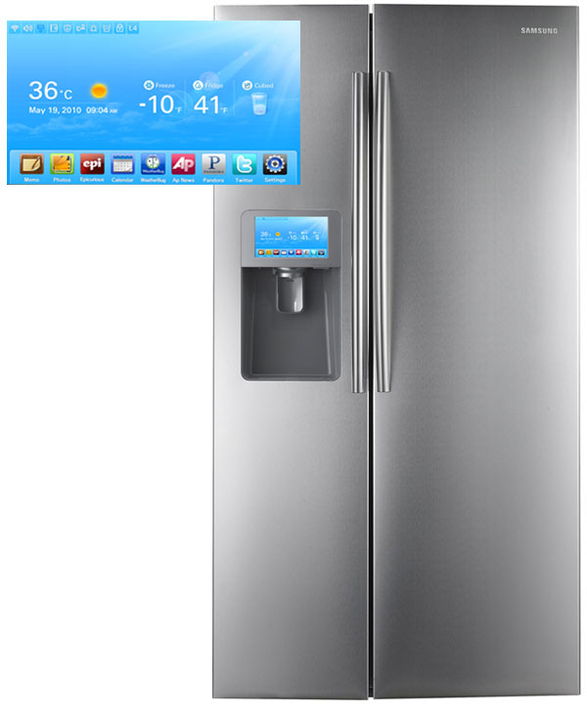
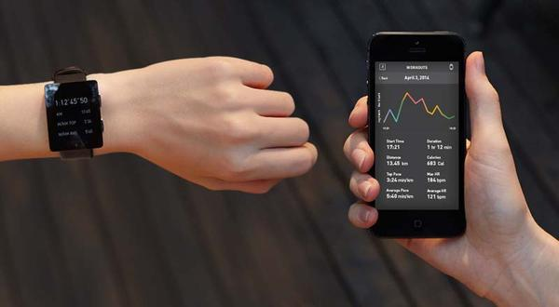
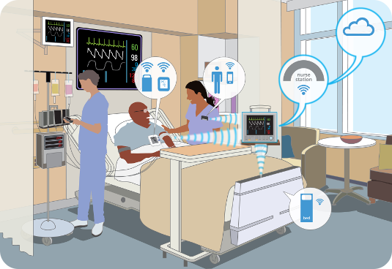
Smart Appliances
Wearable Tech
Healthcare

Slide 19
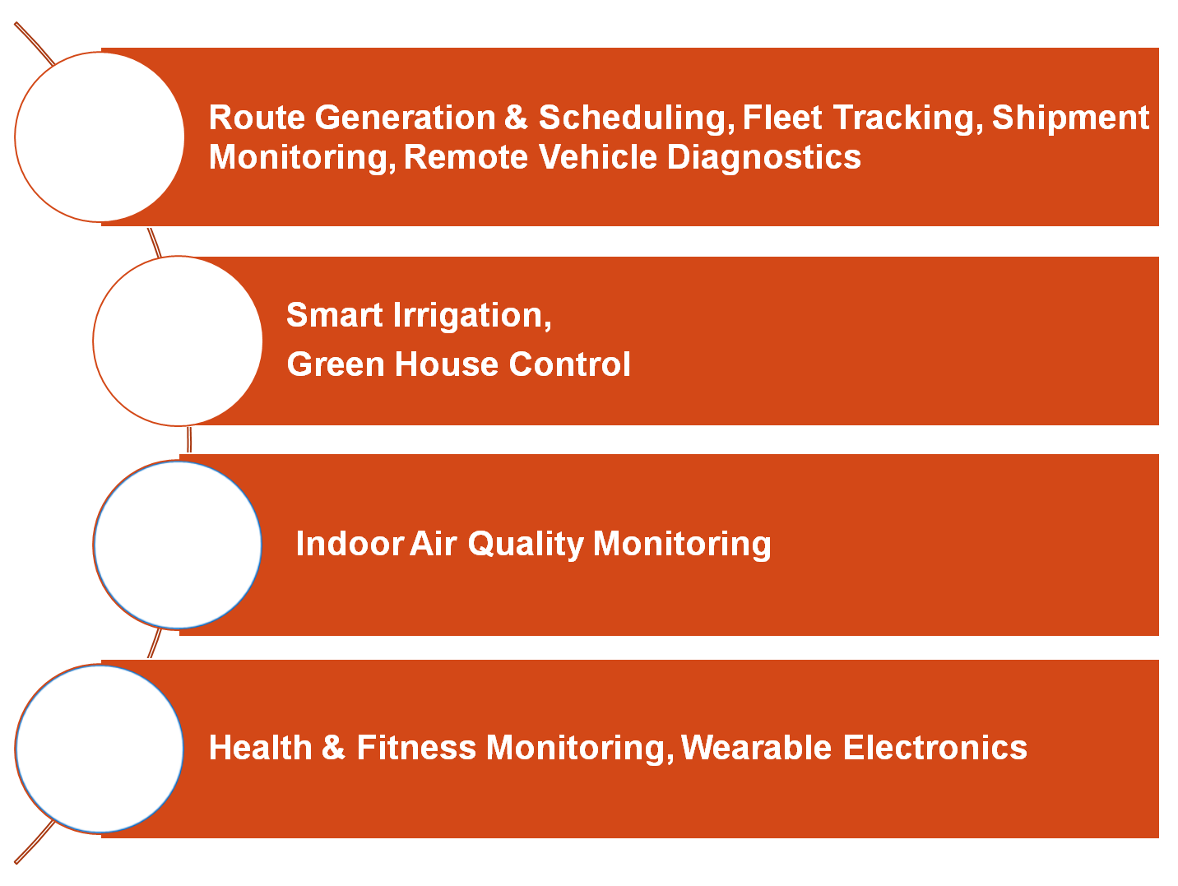
Logistics
Agriculture
Industry
Health and Life Style

Slide 20
Threat vs. Opportunity
Information Security
Office of Budget and Finance
Education – Partnership – Solutions
If misunderstood and misconfigured, IoT poses risk to our data, privacy, and safety
If understood and secured, IoT will enhance communications, lifestyle, and delivery of services

Slide 21
Characteristics of IoT

Slide 22
IoT devices/systems capable of following characteristics,
Dynamic and Self Adapting (Ex. Surveillance Camera)
Self-Configuring (Ex. Weather Monitoring System)
Interoperable Communication Protocols
Unique Identity (IP address/URI)
Integrated into Information Network

Slide 23
Unique Identity
Every IoT device has a unique identity.
Each device is assigned a unique ID or IP address.
Enables global connectivity.
Helps in:
Device identification
Querying devices
Monitoring device status

Slide 24
Heterogeneity
Network devises ,cloud platform will work together
Operate on different technologies and protocols.
IoT architecture supports heterogeneous networks.
Ensures interoperability among diverse devices.

Slide 25
Integrated into Information Network
IoT devices are integrated with Internet networks.
Connected to cloud and enterprise systems.
Data stored and processed centrally.
Enables remote monitoring and control.
Supports real-time analytics and decision-making.

Slide 26
Scalability
Supports a large number of devices.
Easy to add or remove devices.
Handles large data volumes efficiently.
Cloud computing enables system expansion.

Slide 27
Connectivity
Devices are interconnected through networks.
Supports wired and wireless communication.
Enables real-time data transmission.
Communication technologies:
Wi-Fi
Bluetooth
Zigbee
4G/5G

Slide 28
Sensing & Perception
Sensors measure physical parameters.
Examples:
Temperature
Pressure
Humidity
Motion

Slide 29
Sensing & Perception
Sensors measure physical parameters.
Examples:
Temperature
Pressure
Humidity
Motion

Slide 30
Dynamic & Self-Adapting
Devices adapt to environmental changes.
Automatically adjust based on real-time conditions.
Example: Smart camera auto-adjusts focus.
Supports automatic updates and configuration.

Slide 31
Self-Configuring
Devices configure themselves automatically.
No manual intervention required.
Supports plug-and-play functionality.

Slide 32
Interoperability
Supports multiple communication protocols.
Operates at different protocol layers.
Protocol conversion mechanisms available.
Ensures devices from different manufacturers work together.

Slide 33

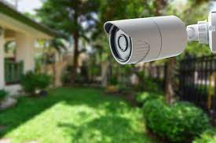
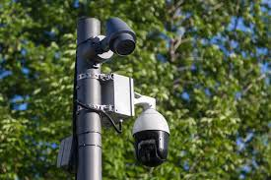
Dynamic and Self Adapting

Slide 34

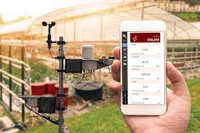
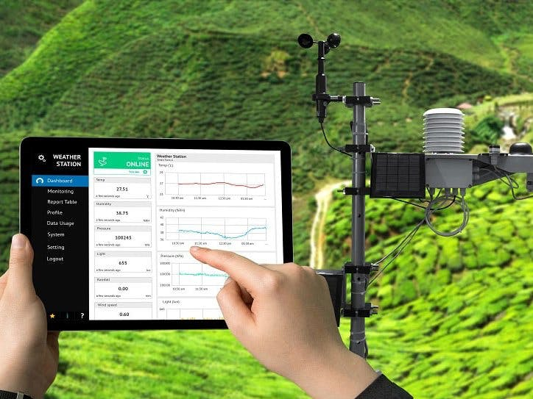
Self-Configuring

Slide 35
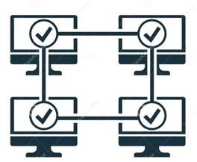
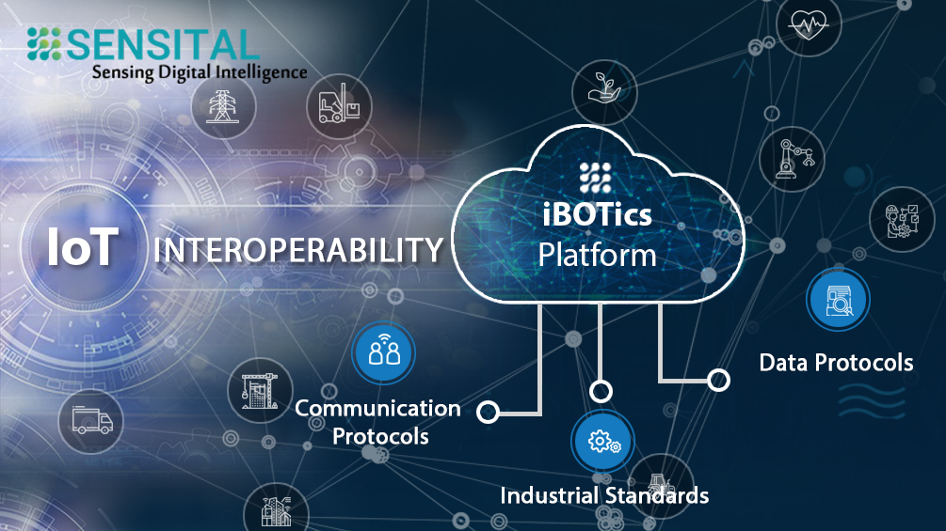
Interoperable Communication Protocols

Slide 36

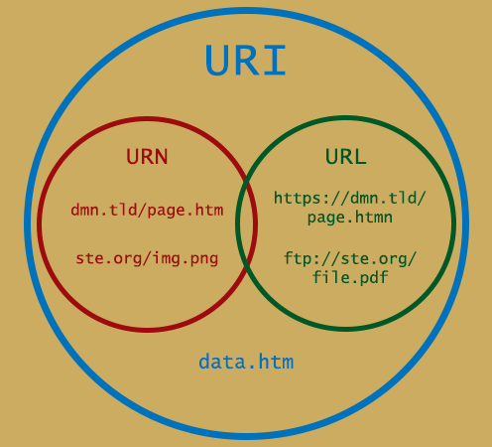
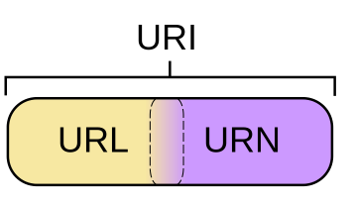
Unique Identity
urn:<NAMESPACE-IDENTIFIER>:<NAMESPACE-SPECIFIC-STRING>

Slide 37

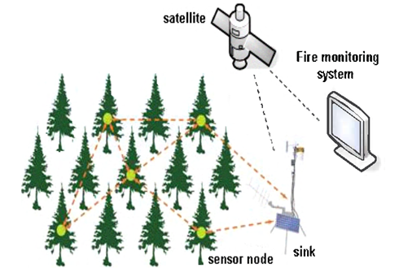
Integrated into Information Network

